Slide 1
Are you addicted to your smartphone?
Stuart Dobson
stuartdobson.net @stuartdotnet
Notes:
Not sure if you've been out in public lately
While you were out, did you get a chance to look up from your phone
If you did, you may have noticed that everyone is addicted to their phones
Tech companies have highly skilled people working out the best way to keep you engaged. Why?

Slide 2
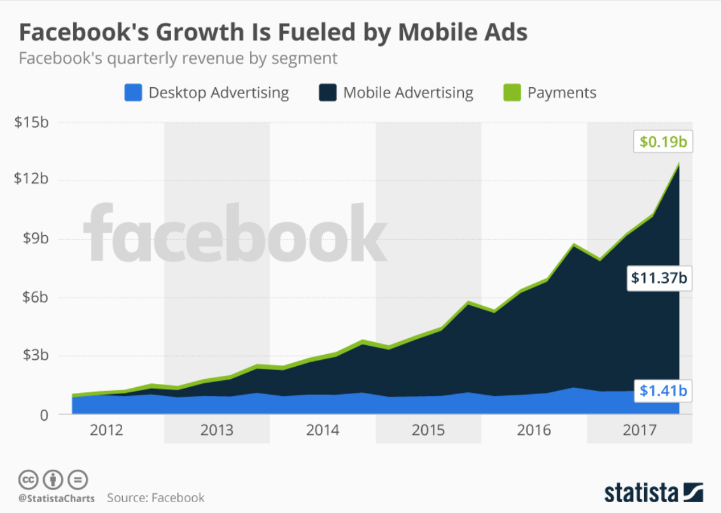
Notes:
Let's go through a few of those tricks

Slide 3
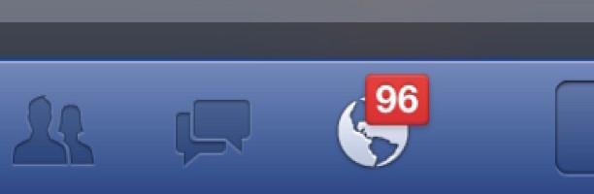
Slot Machine in a billion pockets
Notes:
Little wins
When we pull our phone out of our pocket, we’re playing a slot machine to see what notifications we got.
When we pull to refresh
When we scroll down on insta, see the next photo
When we swipe faces left/right on dating apps like Tinder
When we tap the # of red notifications, we’re playing a slot machine to what’s underneath.

Slide 4
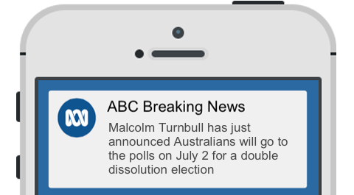
FOMO
Notes:
What if I miss some important news?
What will I miss if I un-friend someone?
What if the next tinder profile is from the heavens?
Truth is, we will always miss something
But if you don’t see it, you don’t miss it

Slide 5
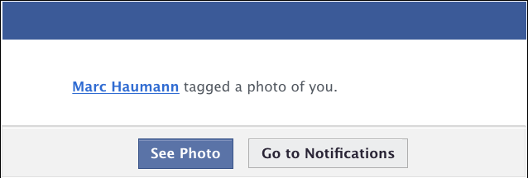
Social Approval
Notes:
Wow he tagged me! But no, Facebook suggested it
LinkedIn, Insta etc automatically adds lots of people - that person wasn’t just thinking about you

Slide 6
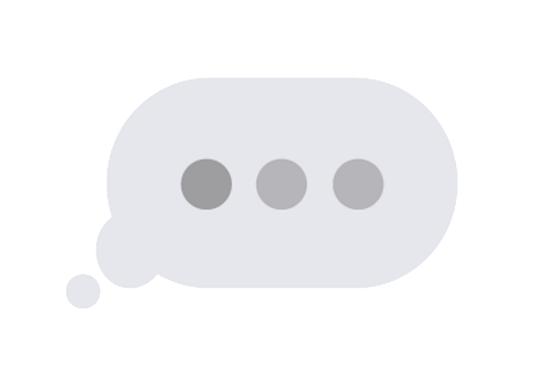
Instant Interruption
Notes:
Forget respectful delivery. Interruption is good for business. Messenger apps tell you when someone has read your message.
Push model

Slide 7
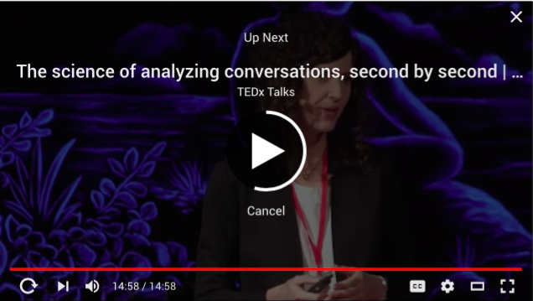
“Bottomless bowls”
Notes:
How to keep people consuming, when they aren’t hungry any more?
Infinite scrolling
YouTube Autoplay
Spotify continues playing
Article websites

Slide 8
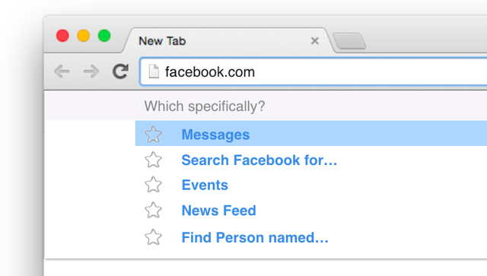
While you’re here...
Notes:
Go to Facebook to do something, 20 minutes later…
Supermarkets have the milk at the back, or pharmacy

Slide 9
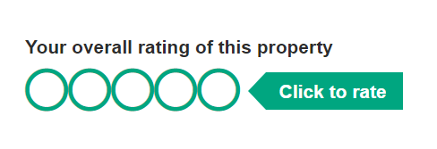
Foot in the Door
Notes:
Used by sales people. Give them an inch..and they’ll take you all day. Not forthcoming about the amount of time it will take

Slide 10
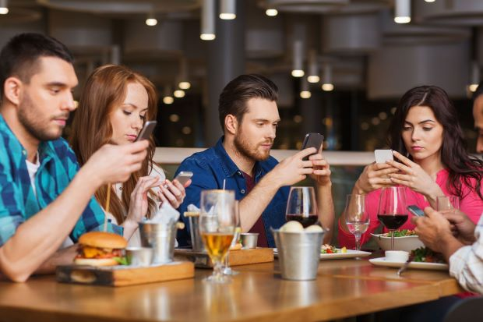
Notes:
Thousands of these techniques.
Dont be these guys. Use technology because YOU want to and recognise when you’re falling victim to these tricks.
The more apps you have, the more chance of being drawn in by these tricks.
When we create apps, we have a choice.
We can enjoy these dirty tricks to engage and probably addict our audience and there's not necessarily anything wrong with that.
But we could instead create UXs that respect users, their time, intelligence, attention, in the same way we protect their privacy.

